Slide 1
SEC Database
GUI Project for EGR 150
Rofael Aleezada
December 9th, 2015

Slide 2
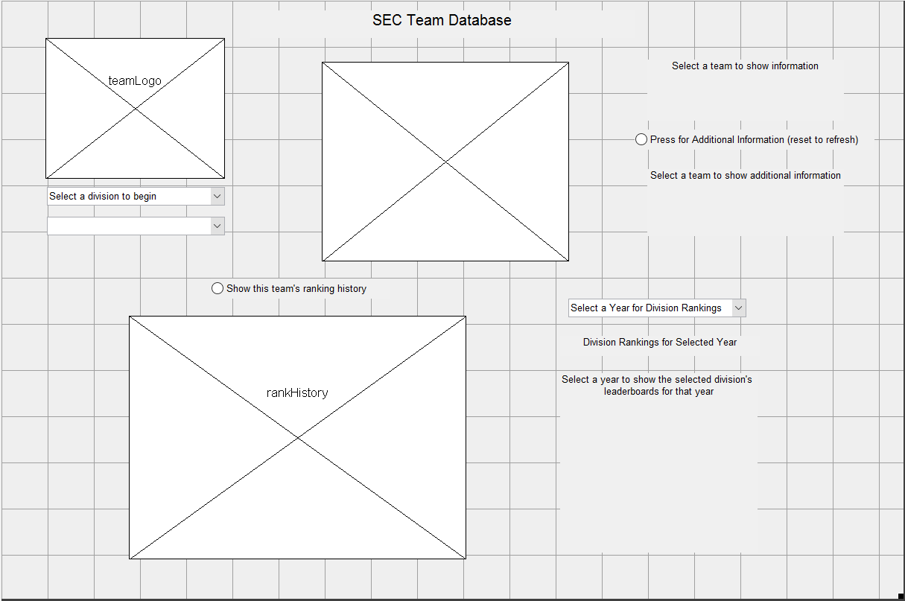

Slide 3
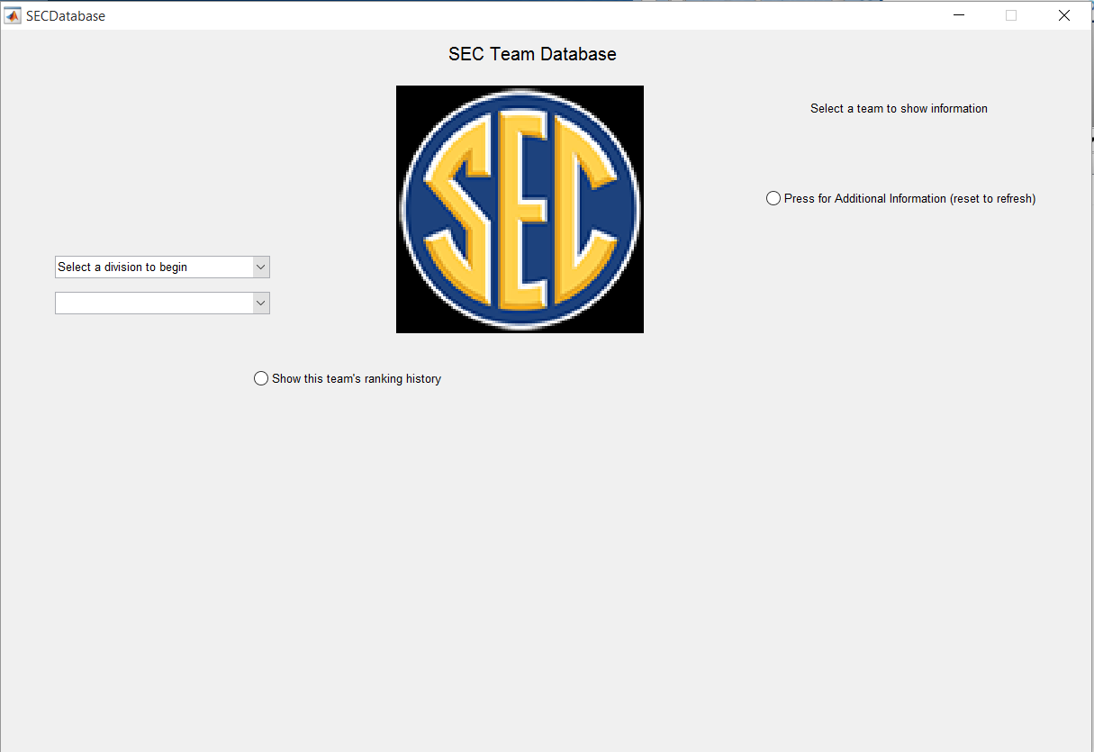

Slide 4
